Slide 1
The Effect of Exchange Rate Volatility on FDI
By: James Chiu
Econ 249A – March 1, 2010

Slide 2
Table of Contents
Introduction
Literature Review
Data
Data Analysis
Technical Analysis
Conclusion

Slide 3
Introduction
Foreign Direct Investment has become an increasingly important form of global business pursued by many multinational enterprises.
This growth of Foreign Direct Investment has become a driving force of economic development in many growing countries through the benefits of technology transfer and increased productivity.
For the investing firm Foreign Direct Investment allows for more efficient allocation of resources.
As a result exchange rates can affect expected future profits of these multinational firms through uncertainty, which can have an adverse effect on Foreign Direct Investment decisions.
Through my analysis I expect to see a positive correlation between host country depreciation and Foreign Direct Investment.

Slide 4
Literature Review
Schmidt, Christian W., Broll, Udo. (2009) The Effect of Exchange Rate Risk on U.S. Foreign Direct Investment: An Empirical Analysis. Dresden Discussion Paper in Economics No. 09/08.
Goldberg, Linda S. (2006).Exchange Rates and Foreign Direct Investment. Princeton Encyclopedia of the World Economy.

Slide 5
Data
Gathered Data for 7 countries in East and Southeast Asia including: China, Hong Kong, Japan, Korea, Singapore, Taiwan and Thailand.
Foreign Direct Investment from the U.S. on a historical cost basis. From the Bureau of Economic Analysis. Specifically FDI in Manufacturing Sector.
Monthly Average Exchange rates gathered from X-rates.com.
    Volatility and yearly averages calculated from 12 month data for years 2000-2008.

Slide 6
Data Analysis (China)

Slide 7
Data Analysis (Hong Kong)

Slide 8
Data Analysis (Japan)

Slide 9
Data Analysis (Republic of Korea)

Slide 10
Data Analysis (Singapore)

Slide 11
Data Analysis (Taiwan)

Slide 12
Data Analysis (Thailand)

Slide 13
Technical Analysis
Conceptual Framework
  LogFDI = ß0+ ß1AR(1) + ß2 XV +ß3 XA
  AR(1) = Autoregressive, Lag 1
  XV = Exchange Rate Volatility
  XA = Average Yearly Exchange Rate

Slide 14
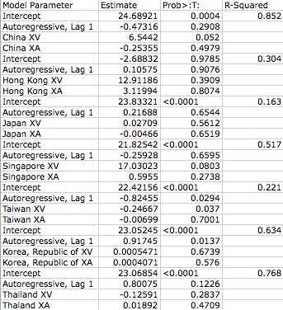
Techinical Analysis Regression Output

Slide 15
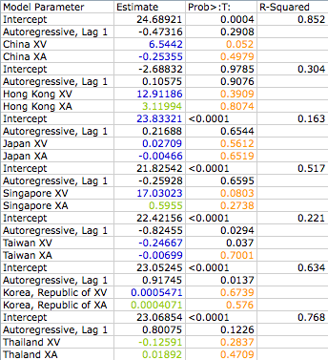
Technical Analysis Highlighted

Slide 16
Conclusion
According to the data from the graphs it seems that the majority of the countries have an positive correlation for Foreign Direct Investment when there is an appreciation of the host currency and higher volatility.
This result goes against interest rate parity conditions.
But, according to the regression results, the majority of the exchange rate volatility and average exchange rate parameter estimates do not pass the 95% confidence interval.
As a result these estimates do not clearly show that an appreciation in the host country exchange rate and higher volatility would increase Foreign Direct Investment.

Slide 17
Questions and Comments
?

